Slide 1
Design and Analysis of Algorithms
Heap Sort
National University of Computer and Emerging Sciences, Islamabad

Slide 2
Heapsort
Running time of heapsort is O(n log₂n)
It sorts in place
It uses a data structure called a heap
The heap data structure is also used to implement a priority queue efficiently

Slide 3
The Heap Data Structure
Def: A heap is a nearly complete binary tree with the following two properties:
Structural property: all levels are full, except possibly the last one, which is filled from left to right
Order (heap) property: for any node x
Parent(x) ≥ x
From the heap property, it follows that:
“The root is the maximum
element of the heap!”
8
7
4
5
2
Heap
A heap is a binary tree that is filled in order

Slide 4
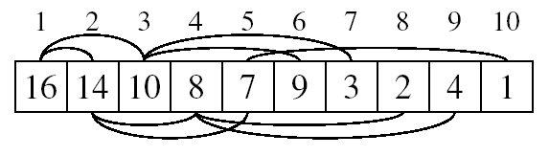
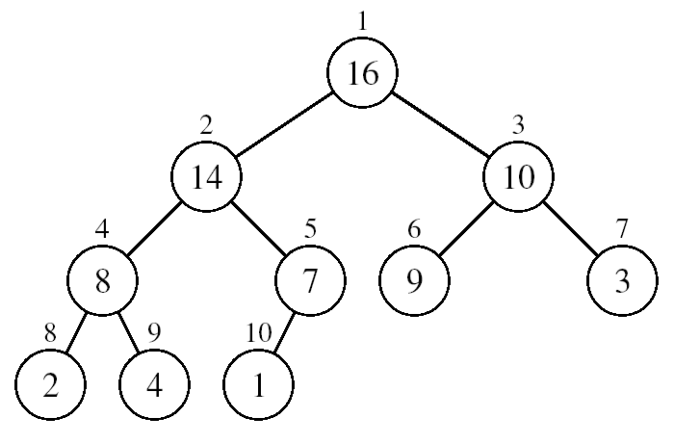
Array Representation of Heaps
A heap can be stored as an array A.
Root of tree is A[1]
Left child of A[i] = A[2i]
Right child of A[i] = A[2i + 1]
Parent of A[i] = A[ ⎣i/2⎦ ]
Heapsize[A] ≤ length[A]
The elements in the subarray A[(⎣n/2⎦+1) .. n] are leaves

Slide 5
Heap Types
Max-heaps (largest element at root), have the max-heap property:
for all nodes i, excluding the root:
A[PARENT(i)] ≥ A[i]
Min-heaps (smallest element at root), have the min-heap property:
for all nodes i, excluding the root:
A[PARENT(i)] ≤ A[i]

Slide 6
Adding/Deleting Nodes
New nodes are always inserted at the bottom level (left to right)
Nodes are removed from the bottom level (right to left)

Slide 7
Operations on Heaps
Maintain/Restore the max-heap property
MAX-HEAPIFY
Create a max-heap from an unordered array
BUILD-MAX-HEAP
Sort an array in place
HEAPSORT
Priority queues

Slide 8
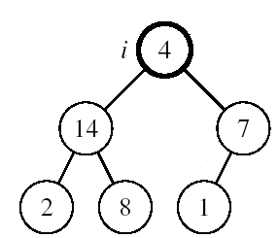
Maintaining the Heap Property
Suppose a node is smaller than a child
Left and Right subtrees of i are max-heaps
To eliminate the violation:
Exchange with larger child
Move down the tree
Continue until node is not smaller than children

Slide 9
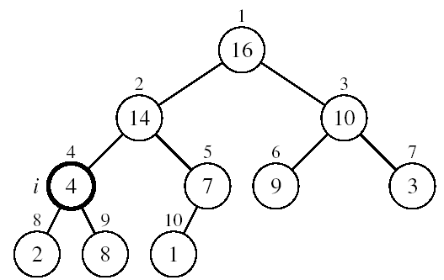
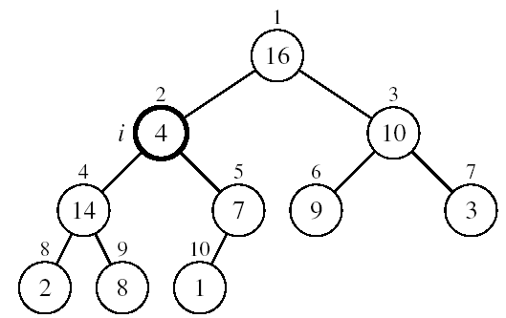
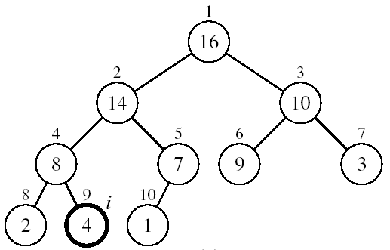
Example
MAX-HEAPIFY(A, 2, 10)
A[2] ↔ A[4]
A[2] violates the heap property
A[4] violates the heap property
A[4] ↔ A[9]
Heap property restored

Slide 10
Maintaining the Heap Property
Alg: MAX-HEAPIFY(A, i, n)
l ← LEFT(i)
r ← RIGHT(i)
if l ≤ n and A[l] > A[i]
then largest ←l
else largest ←i
if r ≤ n and A[r] > A[largest]
then largest ←r
if largest ≠ i
then exchange A[i] ↔ A[largest]
MAX-HEAPIFY(A, largest, n)
Assumptions:
Left and Right subtrees of i are max-heaps
A[i] may be smaller than its children

Slide 11
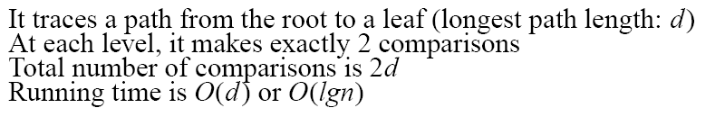
MAX-HEAPIFY Running Time
Intuitively:
Running time of MAX-HEAPIFY is O(lgn)
Can be written in terms of the height of the heap, as being O(h)
Since the height of the heap is ⎣lgn⎦
-
h
-
-
-
2h
O(h)

Slide 12
Building a Heap
Convert an array A[1 … n] into a max-heap (n = length[A])
The elements in the subarray A[(⎣n/2⎦+1) .. n] are leaves
Apply MAX-HEAPIFY on elements between 1 and ⎣n/2⎦
Alg: BUILD-MAX-HEAP(A)
n = length[A]
for i ← ⎣n/2⎦ downto 1
do MAX-HEAPIFY(A, i, n)
1
4
2
3
1
3
4
5
6
7
2
16
9
10
8
9
10
14
8
7
A:
4 | 1 | 3 | 2 | 16 | 9 | 10 | 14 | 8 | 7

Slide 13
Example: A
4 | 1 | 3 | 2 | 16 | 9 | 10 | 14 | 8 | 7
i = 5
i = 4
i = 3
1
1
1
4
4
4
2
3
2
3
2
3
1
3
1
3
1
3
4
5
6
7
4
5
6
7
4
5
6
7
2
16
9
10
2
16
9
10
14
16
9
10
8
9
10
8
9
10
8
9
10
14
8
7
14
8
7
2
8
7
i = 2
i = 1
1
1
1
4
4
16
2
3
2
3
2
3
1
10
16
10
14
10
4
5
6
7
4
5
6
7
4
5
6
7
14
16
9
3
14
7
9
3
8
7
9
3
8
9
10
8
9
10
8
9
10
2
8
7
2
8
1
2
4
1

Slide 14
Running Time of BUILD MAX HEAP
Alg: BUILD-MAX-HEAP(A)
n = length[A]
for i ← ⎣n/2⎦ downto 1
do MAX-HEAPIFY(A, i, n)
O(n)
O(lgn)
⇒ Running time: O(nlgn)
This is not an asymptotically tight upper bound

Slide 15
Running Time of BUILD MAX HEAP
HEAPIFY takes O(h) ⇒ the cost of HEAPIFY on a node i is proportional to the height of the node i in the tree
T(n)=O(n)
Height
Level
No. of nodes
h₀ = 3 (⎣lgn⎦)
i = 0
2⁰
h₁ = 2
i = 1
2¹
h₂ = 1
i = 2
2²
h₃ = 0
i = 3 (⎣lgn⎦)
2³

Slide 16
Running Time of BUILD MAX HEAP
HEAPIFY takes O(h) ⇒ the cost of HEAPIFY on a node i is proportional to the height of the node i in the tree
Height
Level
No. of nodes
h₀ = 3 (⎣lgn⎦)
i = 0
2⁰
h₁ = 2
i = 1
2¹
h₂ = 1
i = 2
2²
h₃ = 0
i = 3 (⎣lgn⎦)
2³
h_{i} = h – i height of the heap rooted at level i
n_{i} = 2^{i} number of nodes at level i

Slide 17
Running Time of BUILD MAX HEAP
Cost of HEAPIFY at level i ∗ number of nodes at that level
Replace the values of n_{i} and h_{i} computed before
Multiply by 2^{h} both at the nominator and denominator and
write 2^{i} as
Change variables: k = h - i
The sum above is smaller than the sum of all elements to ∞
and h = lgn
The sum above is smaller than 2
Running time of BUILD-MAX-HEAP: T(n) = O(n)

Slide 18


Running Time of BUILD MAX HEAP
We can derive a tighter bound by observing that the time for MAX-HEAPIFY to run at a node varies with the height of the node in the tree, and the heights of most nodes are small.
n-element heap has height
at most nodes of any height h
The time required by MAX-HEAPIFY when called on a node of height h is O(h)

Slide 19
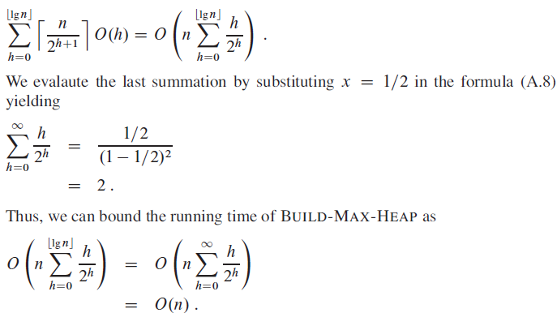
Running Time of BUILD MAX HEAP
Hence, we can build a max-heap from an unordered array in linear time.

Slide 20
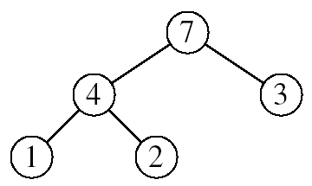
Heapsort
Goal:
Sort an array using heap representations
Idea:
Build a max-heap from the array
Swap the root (the maximum element) with the last element in the array
“Discard” this last node by decreasing the heap size
Call MAX-HEAPIFY on the new root
Repeat this process until only one node remains

Slide 21
BUILD-MAX-HEAP(A)
for i ← length[A] downto 2 do exchange A[1] ↔ A[i]
heap-size[A] ← heap-size[A] – 1 MAX-HEAPIFY(A, 1)
1
16
2
3
14
10
4
5
6
7
8
7
9
3
8
9
10
01
2
4
16 | 14 | 10 | 8 | 7 | 9 | 3 | 2 | 4 | 1
1
2
3
4
5
6
7
8
9
10

Slide 22
BUILD-MAX-HEAP(A)
for i ← length[A] downto 2 do exchange A[1] ↔ A[i]
heap-size[A] ← heap-size[A] – 1 MAX-HEAPIFY(A, 1)
1
1
2
3
14
10
4
5
6
7
8
7
9
3
8
9
10
16
2
4
1 | 14 | 10 | 8 | 7 | 9 | 3 | 2 | 4 | 16
1
2
3
4
5
6
7
8
9
10

Slide 23
BUILD-MAX-HEAP(A)
for i ← length[A] downto 2 do exchange A[1] ↔ A[i]
heap-size[A] ← heap-size[A] – 1 MAX-HEAPIFY(A, 1)
1
14
2
3
8
10
4
5
6
7
4
7
9
3
8
9
10
16
2
1
14 | 8 | 10 | 4 | 7 | 9 | 3 | 2 | 1 | 16
1
2
3
4
5
6
7
8
9
10

Slide 24
BUILD-MAX-HEAP(A)
for i ← length[A] downto 2 do exchange A[1] ↔ A[i]
heap-size[A] ← heap-size[A] – 1 MAX-HEAPIFY(A, 1)
1
14
2
3
8
10
4
5
6
7
4
7
9
3
8
9
10
16
2
1
14 | 8 | 10 | 4 | 7 | 9 | 3 | 2 | 1 | 16
1
2
3
4
5
6
7
8
9
10

Slide 25
BUILD-MAX-HEAP(A)
for i ← length[A] downto 2 do exchange A[1] ↔ A[i]
heap-size[A] ← heap-size[A] – 1 MAX-HEAPIFY(A, 1)
1
1
2
3
8
10
4
5
6
7
4
7
9
3
8
9
10
16
2
14
1 | 8 | 10 | 4 | 7 | 9 | 3 | 2 | 14 | 16
1
2
3
4
5
6
7
8
9
10

Slide 26
BUILD-MAX-HEAP(A)
for i ← length[A] downto 2 do exchange A[1] ↔ A[i]
heap-size[A] ← heap-size[A] – 1 MAX-HEAPIFY(A, 1)
1
10
2
3
8
9
4
5
6
7
4
7
1
3
8
9
10
16
2
14
10 | 8 | 9 | 4 | 7 | 1 | 3 | 2 | 14 | 16
1
2
3
4
5
6
7
8
9
10

Slide 27
BUILD-MAX-HEAP(A)
for i ← length[A] downto 2 do exchange A[1] ↔ A[i]
heap-size[A] ← heap-size[A] – 1 MAX-HEAPIFY(A, 1)
1
10
2
3
8
9
4
5
6
7
4
7
1
3
8
9
10
16
2
14
10 | 8 | 9 | 4 | 7 | 1 | 3 | 2 | 14 | 16
1
2
3
4
5
6
7
8
9
10

Slide 28
BUILD-MAX-HEAP(A)
for i ← length[A] downto 2 do exchange A[1] ↔ A[i]
heap-size[A] ← heap-size[A] – 1 MAX-HEAPIFY(A, 1)
1
2
2
3
8
9
4
5
6
7
4
7
1
3
8
9
10
16
10
14
2 | 8 | 9 | 4 | 7 | 1 | 3 | 10 | 14 | 16
1
2
3
4
5
6
7
8
9
10

Slide 29
BUILD-MAX-HEAP(A)
for i ← length[A] downto 2 do exchange A[1] ↔ A[i]
heap-size[A] ← heap-size[A] – 1 MAX-HEAPIFY(A, 1)
1
9
2
3
8
3
4
5
6
7
4
7
1
2
8
9
10
16
10
14
9 | 8 | 3 | 4 | 7 | 1 | 2 | 10 | 14 | 16
1
2
3
4
5
6
7
8
9
10

Slide 30
BUILD-MAX-HEAP(A)
for i ← length[A] downto 2 do exchange A[1] ↔ A[i]
heap-size[A] ← heap-size[A] – 1 MAX-HEAPIFY(A, 1)
1
9
2
3
8
3
4
5
6
7
4
7
1
2
8
9
10
16
10
14
9 | 8 | 3 | 4 | 7 | 1 | 2 | 10 | 14 | 16
1
2
3
4
5
6
7
8
9
10

Slide 31
BUILD-MAX-HEAP(A)
for i ← length[A] downto 2 do exchange A[1] ↔ A[i]
heap-size[A] ← heap-size[A] – 1 MAX-HEAPIFY(A, 1)
1
2
2
3
8
3
4
5
6
7
4
7
1
9
8
9
10
16
10
14
2 | 8 | 3 | 4 | 7 | 1 | 9 | 10 | 14 | 16
1
2
3
4
5
6
7
8
9
10

Slide 32
BUILD-MAX-HEAP(A)
for i ← length[A] downto 2 do exchange A[1] ↔ A[i]
heap-size[A] ← heap-size[A] – 1 MAX-HEAPIFY(A, 1)
1
8
2
3
7
3
4
5
6
7
4
2
1
9
8
9
10
16
10
14
8 | 7 | 3 | 4 | 2 | 1 | 9 | 10 | 14 | 16
1
2
3
4
5
6
7
8
9
10

Slide 33
BUILD-MAX-HEAP(A)
for i ← length[A] downto 2 do exchange A[1] ↔ A[i]
heap-size[A] ← heap-size[A] – 1 MAX-HEAPIFY(A, 1)
1
8
2
3
7
3
4
5
6
7
4
2
1
9
8
9
10
16
10
14
8 | 7 | 3 | 4 | 2 | 1 | 9 | 10 | 14 | 16
1
2
3
4
5
6
7
8
9
10

Slide 34
BUILD-MAX-HEAP(A)
for i ← length[A] downto 2 do exchange A[1] ↔ A[i]
heap-size[A] ← heap-size[A] – 1 MAX-HEAPIFY(A, 1)
1
1
2
3
7
3
4
5
6
7
4
2
8
9
8
9
10
16
10
14
1 | 7 | 3 | 4 | 2 | 8 | 9 | 10 | 14 | 16
1
2
3
4
5
6
7
8
9
10

Slide 35
BUILD-MAX-HEAP(A)
for i ← length[A] downto 2 do exchange A[1] ↔ A[i]
heap-size[A] ← heap-size[A] – 1 MAX-HEAPIFY(A, 1)
1
7
2
3
4
3
4
5
6
7
1
2
8
9
8
9
10
16
10
14
7 | 4 | 3 | 1 | 2 | 8 | 9 | 10 | 14 | 16
1
2
3
4
5
6
7
8
9
10

Slide 36
BUILD-MAX-HEAP(A)
for i ← length[A] downto 2 do exchange A[1] ↔ A[i]
heap-size[A] ← heap-size[A] – 1 MAX-HEAPIFY(A, 1)
1
7
2
3
4
3
4
5
6
7
1
2
8
9
8
9
10
16
10
14
7 | 4 | 3 | 1 | 2 | 8 | 9 | 10 | 14 | 16
1
2
3
4
5
6
7
8
9
10

Slide 37
BUILD-MAX-HEAP(A)
for i ← length[A] downto 2 do exchange A[1] ↔ A[i]
heap-size[A] ← heap-size[A] – 1 MAX-HEAPIFY(A, 1)
1
2
2
3
4
3
4
5
6
7
1
7
8
9
8
9
10
16
10
14
2 | 4 | 3 | 1 | 7 | 8 | 9 | 10 | 14 | 16
1
2
3
4
5
6
7
8
9
10

Slide 38
BUILD-MAX-HEAP(A)
for i ← length[A] downto 2 do exchange A[1] ↔ A[i]
heap-size[A] ← heap-size[A] – 1 MAX-HEAPIFY(A, 1)
1
4
2
3
2
3
4
5
6
7
1
7
8
9
8
9
10
16
10
14
4 | 2 | 3 | 1 | 7 | 8 | 9 | 10 | 14 | 16
1
2
3
4
5
6
7
8
9
10

Slide 39
BUILD-MAX-HEAP(A)
for i ← length[A] downto 2 do exchange A[1] ↔ A[i]
heap-size[A] ← heap-size[A] – 1 MAX-HEAPIFY(A, 1)
1
4
2
3
2
3
4
5
6
7
1
7
8
9
8
9
10
16
10
14
4 | 2 | 3 | 1 | 7 | 8 | 9 | 10 | 14 | 16
1
2
3
4
5
6
7
8
9
10

Slide 40
BUILD-MAX-HEAP(A)
for i ← length[A] downto 2 do exchange A[1] ↔ A[i]
heap-size[A] ← heap-size[A] – 1 MAX-HEAPIFY(A, 1)
1
1
2
3
2
3
4
5
6
7
4
7
8
9
8
9
10
16
10
14
1 | 2 | 3 | 4 | 7 | 8 | 9 | 10 | 14 | 16
1
2
3
4
5
6
7
8
9
10

Slide 41
BUILD-MAX-HEAP(A)
for i ← length[A] downto 2 do exchange A[1] ↔ A[i]
heap-size[A] ← heap-size[A] – 1 MAX-HEAPIFY(A, 1)
1
3
2
3
2
1
4
5
6
7
4
7
8
9
8
9
10
16
10
14
3 | 2 | 1 | 4 | 7 | 8 | 9 | 10 | 14 | 16
1
2
3
4
5
6
7
8
9
10

Slide 42
BUILD-MAX-HEAP(A)
for i ← length[A] downto 2 do exchange A[1] ↔ A[i]
heap-size[A] ← heap-size[A] – 1 MAX-HEAPIFY(A, 1)
1
3
2
3
2
1
4
5
6
7
4
7
8
9
8
9
10
16
10
14
3 | 2 | 1 | 4 | 7 | 8 | 9 | 10 | 14 | 16
1
2
3
4
5
6
7
8
9
10

Slide 43
BUILD-MAX-HEAP(A)
for i ← length[A] downto 2 do exchange A[1] ↔ A[i]
heap-size[A] ← heap-size[A] – 1 MAX-HEAPIFY(A, 1)
1
1
2
3
2
3
4
5
6
7
4
7
8
9
8
9
10
16
10
14
1 | 2 | 3 | 4 | 7 | 8 | 9 | 10 | 14 | 16
1
2
3
4
5
6
7
8
9
10

Slide 44
BUILD-MAX-HEAP(A)
for i ← length[A] downto 2 do exchange A[1] ↔ A[i]
heap-size[A] ← heap-size[A] – 1 MAX-HEAPIFY(A, 1)
1
2
2
3
1
3
4
5
6
7
4
7
8
9
8
9
10
16
10
14
2 | 1 | 3 | 4 | 7 | 8 | 9 | 10 | 14 | 16
1
2
3
4
5
6
7
8
9
10

Slide 45
BUILD-MAX-HEAP(A)
for i ← length[A] downto 2 do exchange A[1] ↔ A[i]
heap-size[A] ← heap-size[A] – 1 MAX-HEAPIFY(A, 1)
1
2
2
3
1
3
4
5
6
7
4
7
8
9
8
9
10
16
10
14
2 | 1 | 3 | 4 | 7 | 8 | 9 | 10 | 14 | 16
1
2
3
4
5
6
7
8
9
10

Slide 46
BUILD-MAX-HEAP(A)
for i ← length[A] downto 2 do exchange A[1] ↔ A[i]
heap-size[A] ← heap-size[A] – 1 MAX-HEAPIFY(A, 1)
1
1
2
3
2
3
4
5
6
7
4
7
8
9
8
9
10
16
10
14
1 | 2 | 3 | 4 | 7 | 8 | 9 | 10 | 14 | 16
1
2
3
4
5
6
7
8
9
10

Slide 47
BUILD-MAX-HEAP(A)
for i ← length[A] downto 2 do exchange A[1] ↔ A[i]
heap-size[A] ← heap-size[A] – 1 MAX-HEAPIFY(A, 1)
1
1
2
3
2
3
4
5
6
7
4
7
8
9
8
9
10
16
10
14
1 | 2 | 3 | 4 | 7 | 8 | 9 | 10 | 14 | 16
1
2
3
4
5
6
7
8
9
10

Slide 48
Running time of Heapsort
HEAPSORT(A)
1 | BUILD-MAX-HEAP(A) |  |  |  |  |  | O(n)
2 | for i ← length[A] |  |  | downto | 2 | do | O(n-1)
3 | exchange A[1] | ↔ | A[i] |  |  |  |  |  | O(1)
4 | heap-size[A] | ← | heap-size[A] |  |  |  | – | 1 | O(1)
5 | MAX-HEAPIFY(A, |  | 1) | O(lg |  |  |  |  |  | n)
Total time is:
O(n) + O(n-1) * [ O(1) + O(1) + O(lg n) ]
which is approximately
O(n) + O(n lg n)
or just O(n lg n)

Slide 49
Alg: HEAPSORT(A)
BUILD-MAX-HEAP(A)
for i ← length[A] downto 2
do exchange A[1] ↔ A[i]
MAX-HEAPIFY(A, 1, i - 1)
Running time: O(nlgn) --- Can be shown to be Θ(nlgn)
O(n)
n-1 times
O(lgn)

Slide 50
Reference
Introduction to Algorithms
Chapter # 6
Thomas H. Cormen
3rd Edition

